Slide 1
O27 Contractor Quarterly Update: Environmental, Health & Safety
Newport News Shipbuilding
A Division of HII
Vince Constande, Contractor Operations
Virginia Buskee, Contractor Programs
Renee Chabot, Manager OCC Health & Safety 2
Jack Heald, Environmental Manager 3
October 7, 2022

Slide 2
O27 Contractor Safety Talking Points
Overview:
Significant Accidents & Near Misses
Getting Back to Basics
Environmental News
Questions

Slide 3
Contractor Safety Performance
Heinrich’s Theory, Incident Ratio Model
1
29
300
3000
Death or Serious Injury
Minor Injury
Near Miss
Unsafe Acts, Behaviors or Conditions
¹ Herbert William Heinrich
Notes:
Explain (brief)
Heinrich’s conclusion: The relationship [of worker behavior and accidents] was first proposed in 1931 by Herbert William Heinrich in his book Industrial Accident Prevention: A Scientific Approach. Heinrich was a pioneer in the field of workplace health and safety.
Heinrich's theory also suggested that 88% of all accidents were caused by a human decision to carry out an unsafe act.
Point out where we are on the pyramid (Serious Injury)

Slide 4
Significant Accidents & Near Misses
Forklift Operation: Serious Injury
Task
Use a forklift to separate, lift, and carry one plate to the blast shack.
Each plate weighed over TWO tons.
Plates stacked one on top of the other without dunnage separating the plates.

Slide 5
Significant Accidents & Near Misses
Forklift Operation: Serious Injury
Actions
Two employees (helpers) assisting the operator.
The operator partially inserted the forks under the top plate and raised the plate.
The helpers approached the load, stopping directly in front of the elevated plate.

Slide 6
Forklift Operation: Serious Injury
Helpers realized the top plate was not high enough to place the dunnage.
The forklift operator attempted to raise the load to provide additional space.
The plate shifted, slid forward and fell.
Significant Accidents & Near Misses

Slide 7
Forklift Operation: Serious Injury
The plate struck one of the helpers in the lower leg, pinning one leg under the plate.
The operator raised the plate just high enough to free the helper.
The patient was transported to the hospital for leg injuries.
Significant Accidents & Near Misses

Slide 8
Significant Accidents & Near Misses
Bilge Keel Ultra High Pressure (UHP) Waterjet Cutting
Task
Performing UHP Water Jet Cutting on CVN 74 Bilge Keel in Dry Dock 11.
Operational pressure was in excess of 30,000 PSI with garnet infused water.

Slide 9
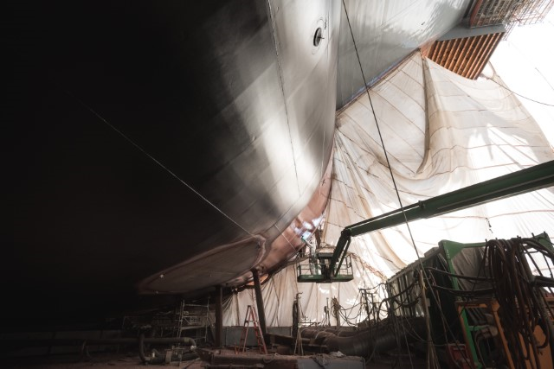
Significant Accidents & Near Misses
Bilge Keel Ultra High Pressure (UHP) Waterjet Cutting
Actions
During the operation, the machine’s cutting head became dislodged and began to flail.
The cutting head contacted the operator multiple times inflicting severe lacerations.
Medics used a personnel float and crane to remove the patient from the dry dock.
Patient transported to regional emergency department for surgery immediately upon arrival.

Slide 10
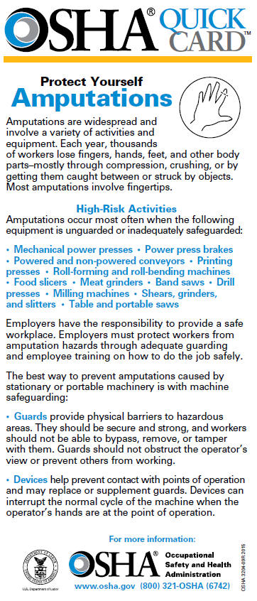
Significant Accidents & Near Misses
Amputation
Contractor employee attempting to clear an interference between two machine parts.
The machine cleared 1 of 2 obstructions as planned.
While attempting to clear the second area, the machine bound.
Caught employee’s hand between sections of the machine and severed a portion of employee’s finger.
Patient transported to regional emergency department for surgery upon arrival.

Slide 11
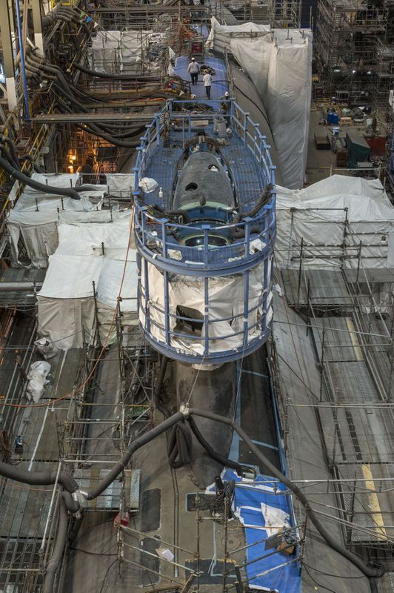
Significant Accidents & Near Misses
Uncontrolled Release of Hazardous Energy: Inadvertent Pressurization of a Blast Hose
Equipment:
4 person Blast Pot
1 blast hose routed to a blast shack
1 blast hose routed to future work site
Description:
Abrasive blasting small parts inside a blasting containment.
Returned from lunch and found the blaster’s hose not operating.
An unauthorized/untrained employee determined the electrical line was not connected to the blast pot.

Slide 12
Significant Accidents & Near Misses
Uncontrolled Release of Hazardous Energy: Inadvertent Pressurization of a Blast Hose
Connected power to the wrong blast hose.
When the blast operator triggered the deadman control, it operated the wrong blast hose and released pressurized air and blast media residue each time he triggered the deadman.
The unrestrained blast hose flailed about exposing NNS trades to:
Struck by hazards
Blast media exposure to eyes, nose, and mouth
High noise

Slide 13
Significant Accidents & Near Misses
Uncontrolled Release of Hazardous Energy: Inadvertent Pressurization of a Blast Hose
Employees reported to Clinic for evaluation.
Investigation revealed the abrasive blast media contained Beryllium, although the product SDS stated otherwise.

Slide 14
Significant Accidents & Near Misses
More……
Struck an electrical duct bank with an auger bit for a pile installation.
Damaged electrical conduit while grading the CLB Heavy Haul Roadway.
Cut a 480VAC cable with a reciprocating saw in pump house #7 at DD #12.
Struck a 23kV cable with an auger pile installation rig on the north end of the Turning Station project.
Damaged conduit and cables using a jack hammer to demo concrete in B1908 (FPB). It caused a short between 480VAC phases.

Slide 15
Back to Basics
Safety, Health, Environmental and Radiological Expectations:
Contractors, Subcontractors, and their Suppliers, at all tiers performing on site must comply with Newport News Shipbuilding requirements, and all other applicable state and federal regulations
Provide workers with sufficient knowledge, skill and experience
Designate Competent or Qualified Persons when required
Provide sufficient project management and EH&S oversite

Slide 16
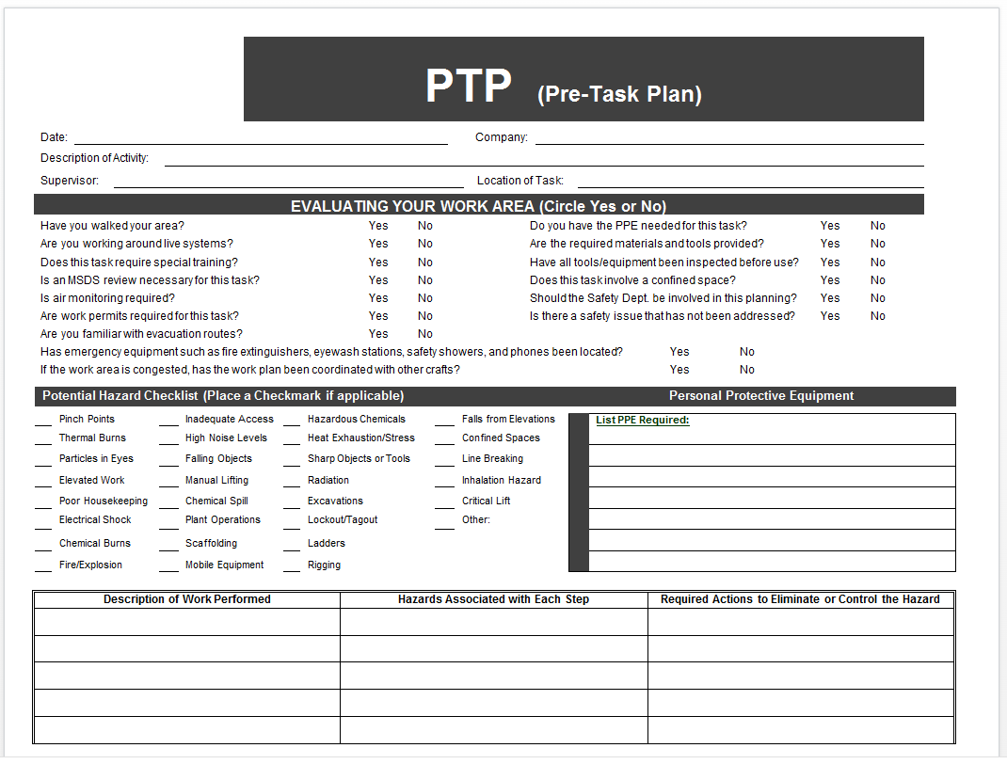
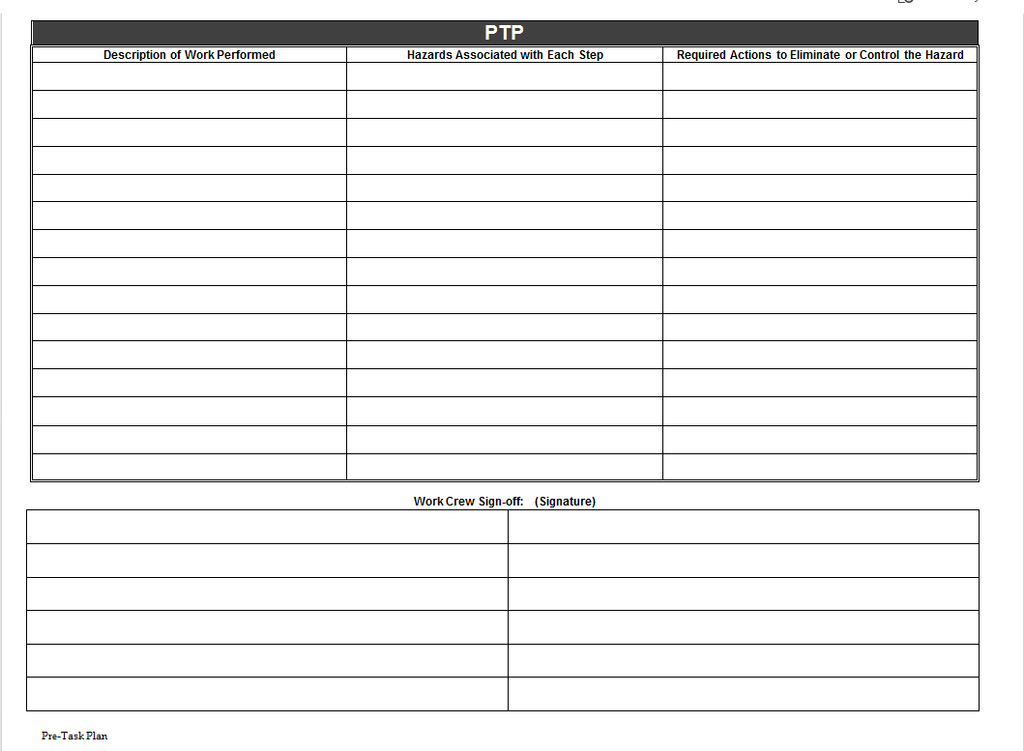
Back to Basics
Recognize, Evaluate, and Control (REC)
Document with Pre-Task Plan (PTP)
Complete PTP daily or for each new definable feature of work
If the plan changes, stop, update and brief the PTP
All personnel assigned to the job must understand hazards, mitigation strategies, execution of mitigation AND sign the PTP
Maintain adequate supervision and safety oversite for contracted work

Slide 17
Back to Basics
Contractor’s Lifting & Handling (L&H) Operations Briefing
Attend NNS Contractor’s L&H Operations Briefing
Provide Properly written Lift Plans for all L&H lifts, not just crane L&H operations
Lift plan Pre-Job Brief: Not an option. It is a requirement
All potential accidents shall be reported and investigated as dictated by NNS procedure SSP Y-1046
Notes:
At a minimum lift plans must include:
Weight of the job and how determined
CG location and how determined
Rigging gear, arrangement and WLL in arrangement configuration
Lifting equipment capacity in the configuration used
Sketches and/or calculations as needed
Is the job “High Risk”
Consider – lift sequence/movement, lifting equipment restrictions/limits, clearances, travel path, landing site. Weather, others.

Slide 18
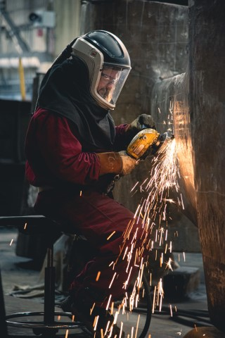
Back to Basics
Hot Work, Fire Prevention/Protection
Provide qualified and authorized employees
Fire extinguisher selection, placement, operation, inspection and maintenance
Understand 35’ rule
Hot/Cold Work Permits
Flammable lockers and storage requirements
Portable fuel storage “cubes” and storage tanks
Housekeeping
Emergency Number - (757) 380-2222

Slide 19
Back to Basics
Point of Contact (POC) for Contractor Rented/Leased Equipment
Equipment that is delivered to NNS must have a POC posted with:
Company Name
Name of POC
POC phone number or company phone number

Slide 20
Back to Basics
Point of Contact (POC) for Contractor Rented/Leased Equipment
Equipment includes but not limited to:
Compressed gas cylinders
Fire extinguishers
Conex box and trailers
Mobile equipment
Personnel handling equipment

Slide 21
Back to Basics
Pedestrian and Traffic Safety
Drivers, passengers, and pedestrians are responsible for obeying ALL traffic rules and regulations
Vehicle and mobile equipment operators are prohibited from holding a handheld personal communication device (e.g., mobile phone) while operating any motor vehicle, mobile equipment, or bicycle on shipyard property
All vehicles, mobile equipment, and pedestrians must yield to emergency vehicles at all times
Vehicular traffic, including bicycles and mobile equipment shall not exceed 15 mph when on company property unless posted otherwise

Slide 22
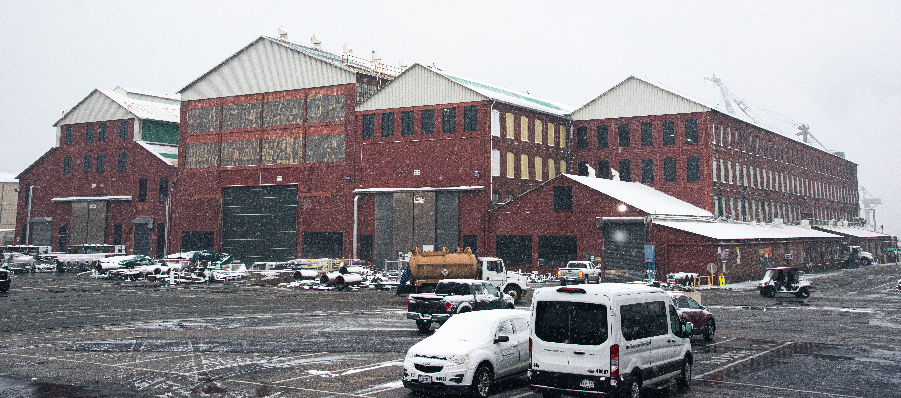
Back to Basics
Pedestrian and Traffic Safety
Vehicular traffic shall not operate between 6:00 a.m. to 6:10 a.m.; 12:00 noon to 12:10 p.m.; 3:30 p.m. to 3:40 p.m.; and between 12:00 a.m. and 12:10 a.m., unless otherwise posted
Motor vehicles and equipment shall not be parked in crane travel paths, within six (6) feet of any railroad track, or within designated walkways or crosswalks
Seat belts shall be worn by the motor vehicle operator and all passengers when operated on company property

Slide 23
Back to Basics
Pedestrian and Traffic Safety
Personal Entertainment Devices (PEDs)
Headphones and ear buds use with PEDs are also prohibited when transitioning to and from a jobsite or to start or end a work shift, even though PPE may not be required at those times. This rule applies to pedestrians, vehicle operators, bicycle riders, and mobile equipment/personnel handling equipment operators

Slide 24

Back to Basics
Excavations / Trench
OSHA National News Release
U.S. Department of Labor
July 14, 2022
Alarming rise in trench-related fatalities spurs US Department of Labor to announce enhanced nationwide enforcement, additional oversite
22 workers have perished in first half of 2022
Washington-In 2022’s first six months, 22 workers have fallen victim to the deadly hazards present in trenching and excavation work – surpassing 15 in all of 2021 – and prompting the U.S. Department of Labor’s Occupational Safety and Health Administration to launch enhanced enforcement initiatives to protect workers from known industry hazards.

Slide 25

Back to Basics
Excavations / Trench
Never enter a trench unless:
It has been properly inspected and documented by a competent person
Cave-in protection measures are in place
There is a safe way to enter and exit
Equipment and materials are away from the edge
Strict adherence to OSHA 1926 Subpart P

Slide 26
Back to Basics
Excavations / Trench
It is free of standing water and atmospheric hazards
Trenches 5 feet deep or greater require a protective system
If excavations are less than 5 feet in depth and examination of the ground by a competent person provides indication of a potential cave-in, provide a protective system
Strict adherence to OSHA 1926 Subpart P

Slide 27

O27 Environmental
Jack Heald, Manager Environmental Engineering 3

Slide 28
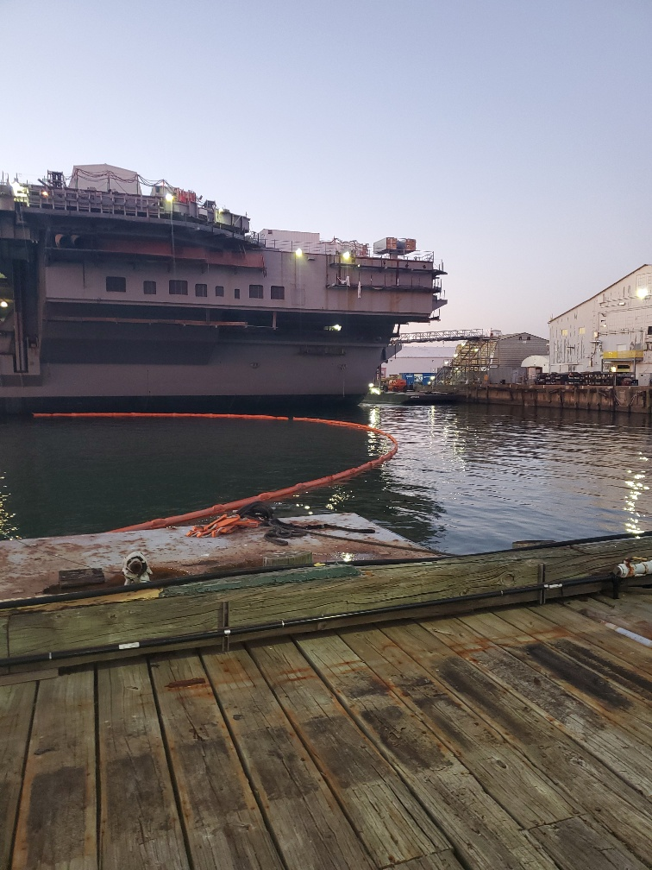
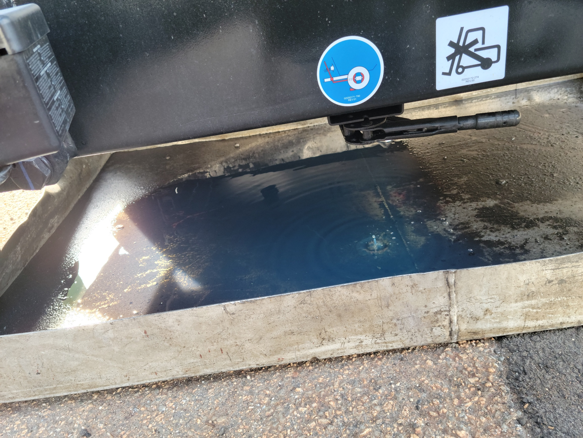
Trends
Reportable Spills
 | Total Spills | Reportable Spills
September | 6 | 5
August | 7 | 0
July | 2 | 1
June | 6 | 2
May | 2 | 0
April | 5 | 1
March | 5 | 2
Trends
Repeat issues: capping hoses, etc.
Operational errors
Take time
Call 757-380-2222

Slide 29

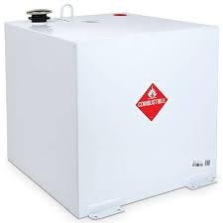

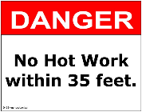
News
Portable Fuel Cubes- Spill Prevention Control & Countermeasures (SPCC) Plan
Areas/containers storing oil & fuel, 55-gallons or more
O27 approval
Includes fuel cubes brought in by contractors
Up to 660 gallons
Double-walled
Fire extinguishers & spill kits
Posting with NFPA 704 Diamond
Ownership information
Facility and shipboard
Monthly inspections-facility
Weekly inspections-shipboard
NNS Contact:____________
Phone:__________________
Owning/leasing Dept_____
Contractor contact:_____
Contractor Phone:_______

Slide 30
Reminder
Demolitions & Renovations
Shipyard began in 1886
Many buildings are 1900s-1970s construction
Asbestos
Cables
Paints with metals
PCBs in paint, light ballasts, window glazing & caulking
PCBs remaining in drained transformers
Lead sheathing
Shipyard was expanded in stages

Slide 31
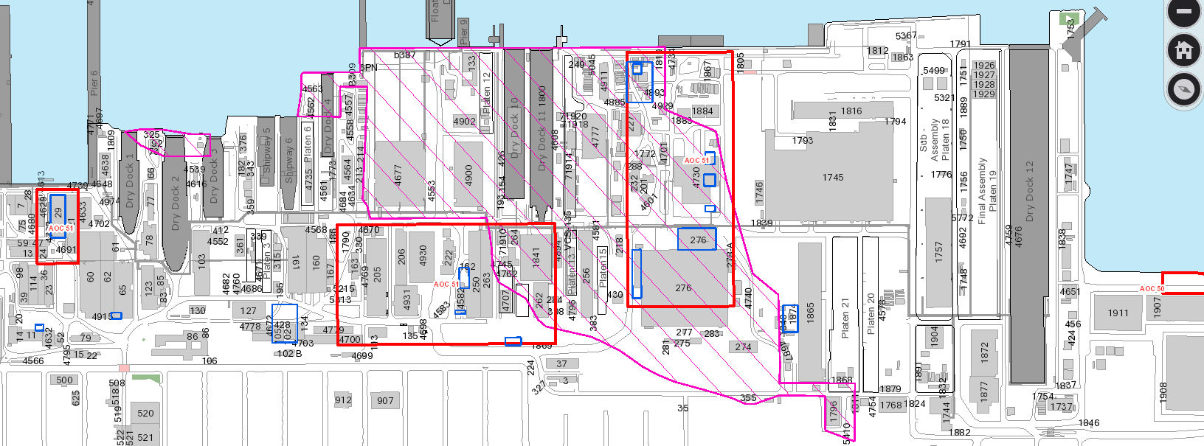
NNS Historical Map: Asbestos, Unknown Fill, SWMU

Slide 32
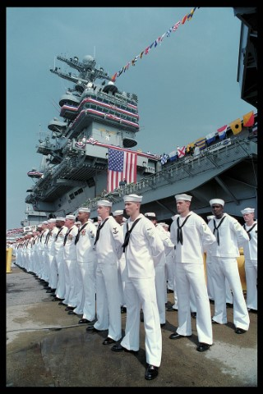
Contractor Safety Meeting
Questions?

