Slide 1
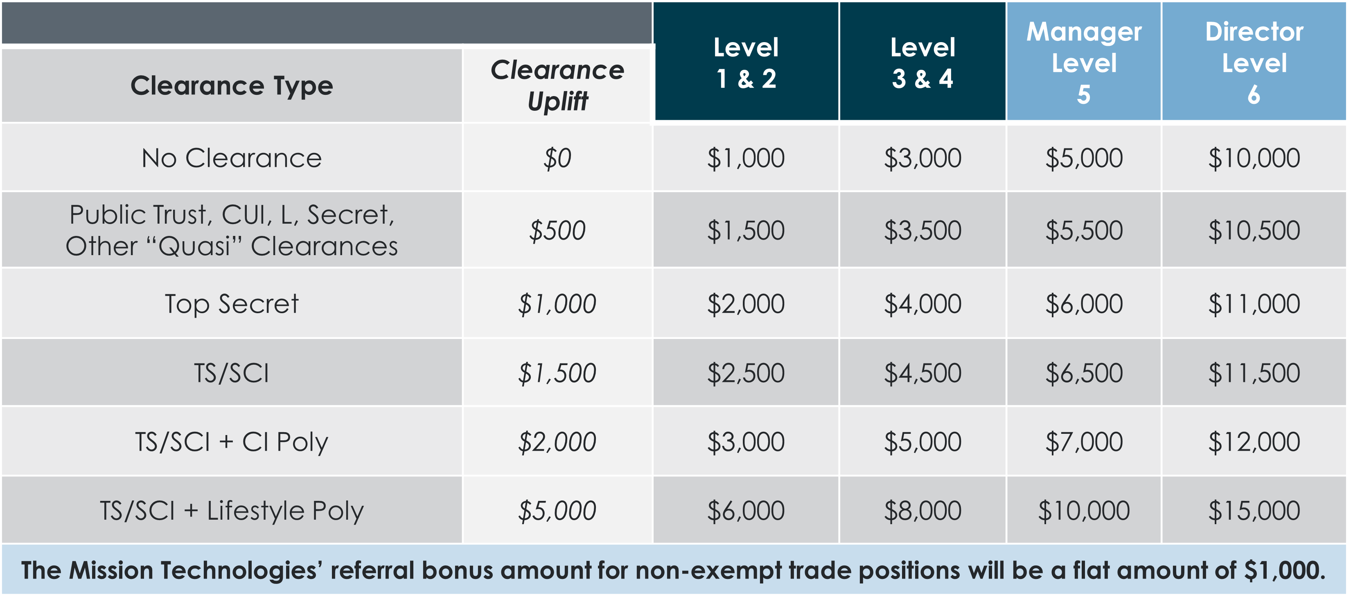
Your Mission: Multiply Our Division
Bonuses range from $1,000 to $15,000!
It’s easy to refer your friends or family to our open positions via MyHR
Notes:
HII offers lucrative referral bonuses for bringing talented individuals to join the team:
Bonuses range from $1,000 to $15,000, depending on the clearance level and position referred.
Employees can submit referrals through MyHR, by selecting the "Refer Friend to Job" option.
There is no limit on the number of referral bonuses an employee can receive.
Ensure you follow referral qualification steps to maximize rewards and support recruitment efforts.

