Slide 1

SPARS: Shipbuilding Partners and Suppliers
Software Submittals – Submitting Electronic Technical Documentation
Newport News Shipbuilding

Slide 2
Shipbuilding Partners and Suppliers (SPARS)
SPARS is a secure web portal for suppliers to submit their software documents electronically with no cost to the supplier.
  Gives suppliers the capability to submit Request for Quote (RFQ) questions via Vendor Quote or technical documents such as Vendor Information Requests (VIRs) directly to NNS Engineering.
  Other submittal types include the below for clarification or approval on drawings, procedures, or technical manuals:
    Purchase Order Refresh Actions (PORAs)
    Vendor Drawing for Engineering Reviews (VDERs)
    Vendor Procedure Approval Reviews (VPARs)

Slide 3
Who can use SPARS and what are the advantages?
SPARS is available to all suppliers, however the Supplier must be eligible for electronic CUI transmissions to share/receive CUI:
Advantages include:
No mail costs to submit documents for approval
Eliminates the time required for postal delivery
Timely confirmation of submittals
Automatic email notifications and updates when the status
Real-time feedback, producing a tracking number for each submittal
Comments can be returned electronically with submitted documents
Serves as a permanent record for the Supplier
Questions are answered by Purchase Order Line Item
NOTE: To be eligible for electronic CUI transmission, you must have completed the NIST Questionnaire through Exostar’s
Onboarding Module application. To determine status and/or seek approval, contact Exostar@hii-nns.com.

Slide 4

How to access SPARS
Access the SPARS website at https://spars.huntingtoningalls.com/ngcspars/Auth

Slide 5
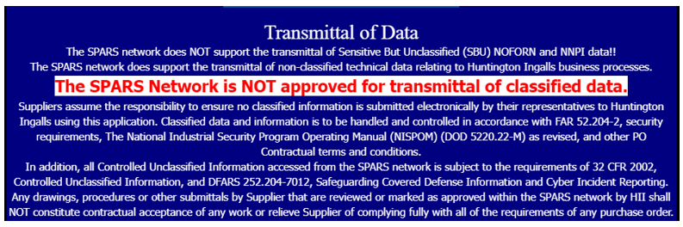
Security - Protection of Data
All Suppliers may be set up for SPARS, however, the information shared within the system will be limited by the Supplier’s CUI Transmission approval.
SPARS is not authorized (prohibited) for the transmittal of data pertaining to or including Nuclear Naval Propulsion Information (NNPI). Never transmit NOFORN, NNPI, or Classified Information via SPARS.
The below warning appears on the log in screen, and Suppliers are reminded via a pop-up box in creating a software submittal in SPARS.

Slide 6
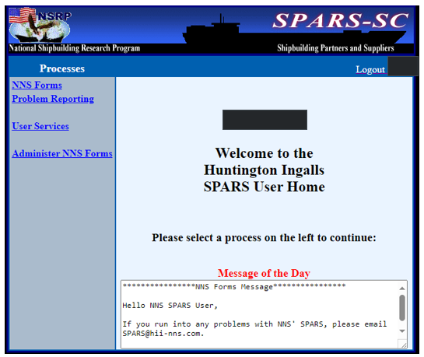
SPARS Landing / Home Page
After logging in, the user selects “NNS Forms” to create, query, or search for the user’s submittals. This sends user to the Active Forms Screen.
“User Services” displays a utility menu to administer their user account. We will go into these details further in the slide deck.

Slide 7
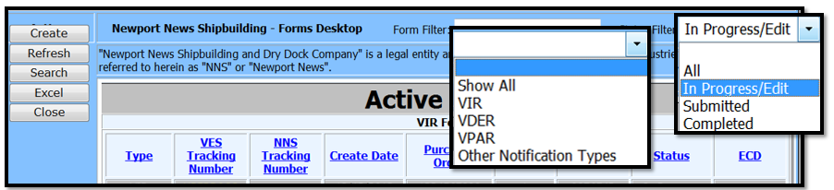
NNS Forms to the Active Forms Screen
This screen is a summary of submitted submittals the user has made and where to start creating submittals.
Upon initial access, the list of submittals will be blank. After creating and submitting a software submittal, the Active Forms screen will serve as a summary of current, past and pending submittals.
The user has the ability to narrow the number of submittals shown on the screen.
  Select a particular type from the Active Forms screen and only those types of submittals will be displayed. (VIR, VDER, VPAR, ETC.)
  The filter for the active forms screen can be set to All, In Progress/Edit, Submitted, or Completed.
Note: Access limited to view user submittals unless access granted as the SPARS Administrator for your company.
Notes:
Active Forms Screen
Once past the NNPI warning, the user is at the “Active Forms” screen.
This screen is a summary of the submittals that the user has made. Initially, this will be blank, but as usage proceeds the Active Forms screen will serve as a summary of current, past and pending submittals.
Once a submittal is created, the Active Forms Screen will have fields as shown and defined on the next screens.
At the Active Forms screen, the user has the ability to narrow the number of submittals shown on the screen.
Select a particular type from the Active Forms screen and only those types of submittals will be displayed, such as VIR, VDER, or VPAR.
The filter for the active forms screen can be set to All, In Progress/Edit, Submitted, or Completed

Slide 8
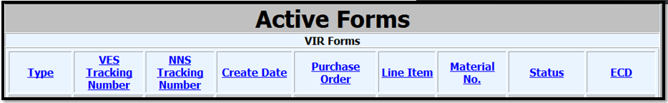
Active Forms: Definitions
Type
  Product being created/submitted to NNS
  Examples: Vendor Information Request (VIR) or Vendor Question (VQ)
VES Tracking Number
  Virtual Enterprise System (VES)
  Internal reference number to SPARS
NNS Tracking Number
  NNS Reference number (QN)
  Only populates when submittal is successfully received by NNS
Create Date
  Date submittal is created/started in SPARS
Purchase Order
  NNS PO (or RFQ for Vendor Quotes)
Line Item
  PO/RFQ item number
Material No.
  NNS part number on PO/RFQ
Status
  Reflects where submittal “stands”; examples: In Progress, Submitted or Completed
ECD
  Estimated Completion Date for NNS review
Notes:
Active Forms: Definitions
Here are the definitions for each of the columns found on the Active Screens page.
“Type” refers to the type of software which was submitted, such as Vendor Information Request (VIR) or Vendor Question (VQ).
“VES Tracking number” is generated by the system automatically once a submittal is made.
“NNS Tracking number” is generated automatically when the submittal has been successfully received, to track progress of the submittal. Use this number to track the activity of a submittal throughout it’s life. After a submittal is received by NNS this field will be populated. This field will always be blank if NNS has not received the submittal.
“Create Date” is when the submittal was first created in the system is done automatically by the system and is recorded here.
“Purchase Order” will be displayed here when the Purchase Order number is typed into the form.
Like the Purchase Order number, the “Line Item” number will be displayed.
“Material number” refers to the Newport News Shipbuilding part number from the Purchase Order
“Status” displays the current status of each document. It will display either “In progress”, “submitted”, or “completed”.
“ECD” is the estimated completion date.
Note: Be very attentive of the following-
1) Purchase order
2) Line Item
3) Material number.
If there are errors on any of these three fields the submission will fail.

Slide 9
Service and Non-Material Number Submittals
The SPARS system requires each submittal to have:
a document number,
line item,
material revision and
material number (part number).
Entering this data accurately is important – if NNS’ system does not have a match, SPARS will not allow the submittal to process and an error will appear on your screen.
If you have a service PO or RFQ where there is NOT a material number associated with the line item, this CANNOT be submitted via SPARS.

Slide 10
Software Submittals
For all contracts to submit a deviation/departure from spec or clarifications and questions of weld/cast repairs and markings or as directed by applicable Coded Notes:
  Vendor Quote (VQ) – Specific for questions or requests on request for quotes (RFQs)
  Vendor Information Request (VIR) – Specific for questions or requests on purchase orders (POs)
  Purchase Order Refresh Action (PORA)
For carrier and non-Virginia Class Submarines (VCS) submittals, the user selects “Create a non-VCS form”.
For Virginia Class Submarines (VCS) submittals only, the user selects either of two forms, depending on need:
  Vendor Drawing for Engineering Review (VDER)
  Vendor Procedure Approval/Review (VPAR)

Slide 11
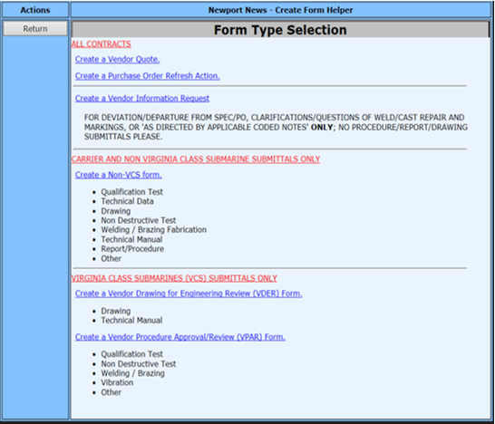
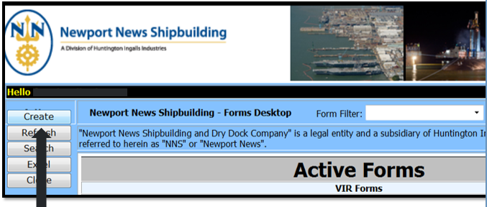

How to Create a Submittal
When the user selects “Create” on the Active Forms screen, they are taken to a selection screen to then pick the type of software submittal.
Notes:
How to Create a Submittal
When the user selects “Create” on the Active Forms screen to begin a submittal, they are taken to a selection screen to select the type of submittal they are making.

Slide 12
Hardcopy Submittals
All Service and Non-Material Number submittals will need to be submitted through mailed hard copy to the below address:
Newport News Shipbuilding
4101 Washington Ave.
Newport News, VA 23607
Attn: E68 Software Coordinator
Bldg. 902-2
This is completed via Form NN3409, Vendor Information Request. A copy can be found on the external Supplier website at Forms - Newport News Shipbuilding Supply Chain Procurement (huntingtoningalls.com).

Slide 13
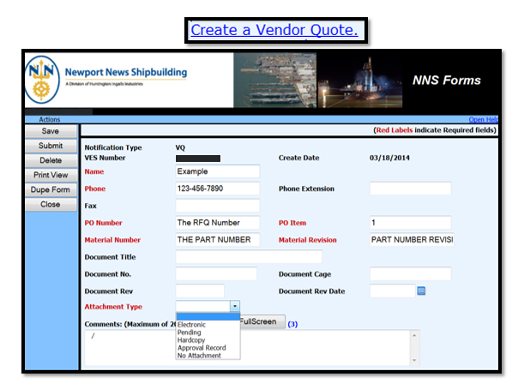
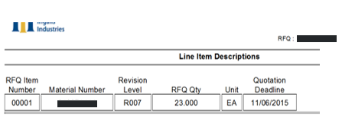
Vendor Quote (VQ) Submittal
The fields in red indicate required fields; for a VQ:
  PO number is the RFQ number
  PO item is the line item on the RFQ
  Material Number and Material Revision are as shown on the RFQ
Notes:
Example: Vendor Question (VQ) Submittal
Any exceptions (Vendor Quotes/Questions) to a RFQ can be made through SPARS.
The fields in red are required fields
The PO Number is the RFQ Number
Material Number and Material Revision are as shown on the RFQ
For other submittals this is the same type information found on the PO

Slide 14
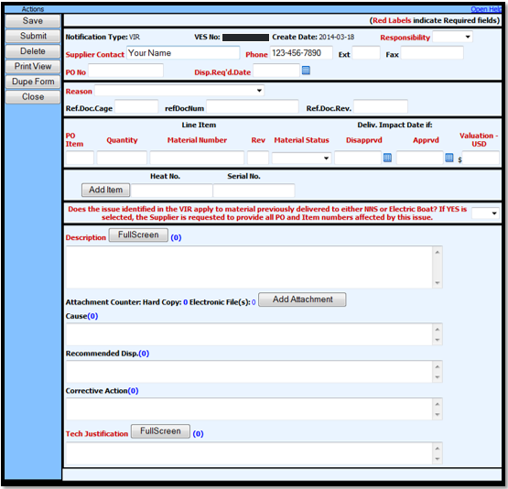
Vendor Information Request (VIR) Submittal
The fields in red indicate required fields for a VIR.
If you have questions on how to submit or issues submitting, contact SPARS@hii-nns.com.
SPARS will not allow submission without these fields being populated and matching the PO information.
Notes:
Example: Vendor Information Request (VIR) Submittal
Exceptions (Vendor Information Request or VIR) to a Purchase Order (PO) can be made through SPARS.
SPARS will not allow submittal without all of the required fields populated.
For more information on submitting a VIR through SPARS, please view the VIR training module.

Slide 15
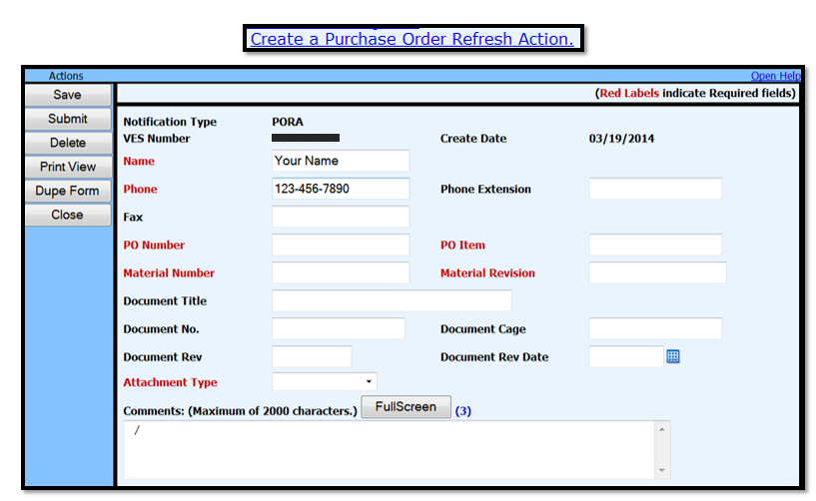
Purchase Order Refresh Action (PORA) Submittal
Notes:
Example: Purchase Order Refresh Action (PORA)
Purchase Order Refresh Actions (PORAs) can be submitted through SPARS as well
Once again, the fields in red are required fields

Slide 16
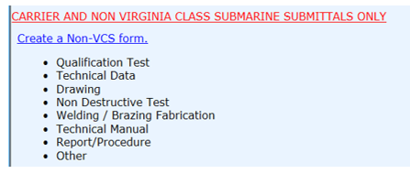
Forms for Carriers and Non-VCS Submarines
A non-VCS submittal form is for Carriers and Non-Virginia Class Submarines ONLY to request the below:
  Drawings
  Non-Destructive Testing procedures
  Qualification Tests
  Report/Procedure including but not limited to Shock and Vibration
  Technical Data
  Technical Manuals
  Welding/Brazing procedures
  Other
Notes:
Forms for Carriers and Non-VCS Submarines
The following submittal types are for Aircraft Carriers and Non-Virginia Class Submarines
Drawings
Non-Destructive Testing procedures
Qualification Tests
Report/Procedure including but not limited to Shock and Vibration
Technical Data
Technical Manuals
Welding/Brazing procedures
Other

Slide 17
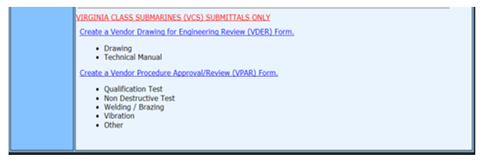
Forms for Virginia Class Submarines (VCS)
The following form submissions are for Virginia Class Submarine (VCS) ONLY:
  Vendor Drawing and Engineering Review (VDER) to request:
    Drawings
    Technical Manuals
  Vendor Procedure Approval Request (VPAR)
    Qualification Tests
    Non-Destructive Testing (NDT)
    Welding/Brazing
    Vibration
Notes:
Forms for Virginia Class Submarines (VCS)
The following forms are for Virginia Class Submarine (VCS) ONLY:
Vendor Drawing and Engineering Review (VDER)
Drawings
Technical Manuals
Vendor Procedure Approval Request (VPAR)
Qualification Tests
Non-Destructive Testing (NDT)
Welding/Brazing
Vibration

Slide 18
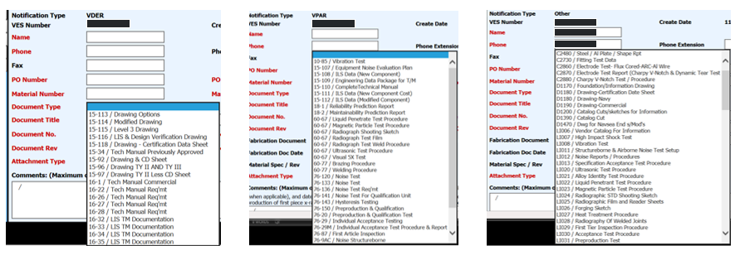
Requirement Driven Submittals
Regardless of the hull, a submitted item is in support of a deliverable requirement of a PPN (Non-VCS) or Standard Clause (VCS).
Drop down lists will require the user to select the appropriate requirement. If not listed, there is an “Other” at the end of the list.
Notes:
Keep in mind that all submittals for qualification documents are driven by the requirements on the PO.
For VCS hulls these are the Electric Boat Standard Clauses.
For Carriers and non-VCS subs these are Newport News Coded Notes.
Under each category there are drop down menus to select from.

Slide 19
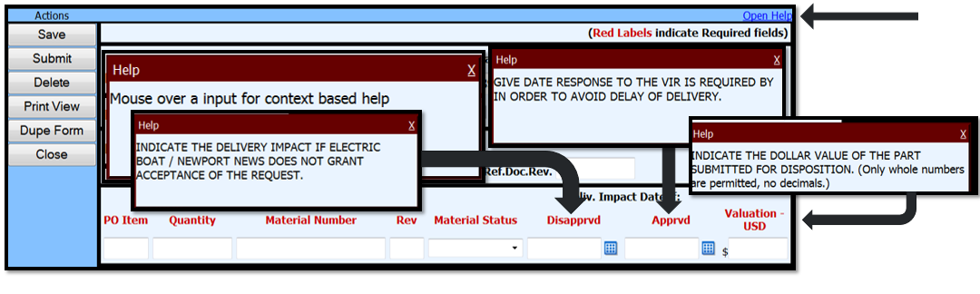
Help
There is a “Help” button to assist with the contents of the entry fields.
Activate “Help” by clicking on “Open Help” in the upper right corner of the submittal screen.
When the user moves the cursor over the field name, helpful information for each field will appear in the window.
Notes:
Help
There is a “Help” menu to assist with the contents of the entry fields.
Activate “Help” by clicking on “Open Help” in the upper right corner of the submittal screen.
When the user moves the cursor over the field name, helpful information for each field should appear in the window.
For example:
Click on Disposition Required Date – This is the date to respond to the VIR. This is required in order to avoid delay of delivery
Click on Disapproved – This is the date of delivery impact if Electric Boat or NNS does not grant acceptance of the request
Click on Valuation – This is the dollar value of the part submitted for disposition (only whole numbers are permitted, no decimals)
Each drop down field will allow the user to make the appropriate selection from that field. It will not allow the user to select something which would not go in that field. And, the user does not have to complete a field not required for the type of submittal being made.
These functions are to remove many of the difficulties which caused delays and mistakes commonly associated with completing the form in the past.

Slide 20
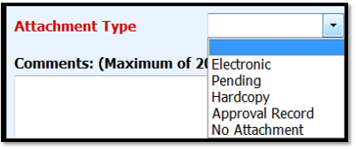
Attachment Types
Attachments can be uploaded or informative write-ups typed into the “Comments” field (up to 2,000 characters).
For each submittal, select the format of the documents being submitted:
Electronic allows the user to link/upload the document using the “browse” button and selecting a file.
Pending is for when the submittal has already been submitted on a different RFQ or PO item. The document must be open and pending approval.
Hardcopy is for when the document requires mailing (paper copy, CD) where an electronic format is not available/attachable.
Approval Record will cause a new field to appear. Enter the applicable Serial Number and date of the approval letter or fax.
No Attachment is to be selected when there are no documents to be attached.
Notes:
Attachment Types
Attachments can be uploaded or informative write-ups typed into the “Comments” field (up to 2000 characters).
For each submittal, select the format of the documents being submitted.
The choices are “Electronic”, “Pending”, “Hardcopy” or “Approval record.”
Selecting “Electronic” will allow the user to link/upload the document using the “browse” button.
“Pending” should be selected when the submittal has already been submitted on a different RFQ or PO item. The document must be open and pending approval.
Hardcopy” shall be selected when the document requires mailing (paper copy, CD) where an electronic format is not available/attachable.
“Approval Record” will cause a new field to appear. Enter the Serial Number and date of the approval letter or fax.
All of the attachments can be uploaded if they are in an electronic format. The file name for the attachments should be descriptive of the contents of the file. This is what is seen by the software processers at NNS. Understanding what is in the file before opening it is a time saver for everyone!

Slide 21

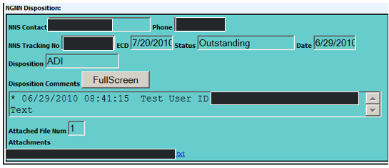
Additional Document Information (ADI)
When additional information or corrections are required by NNS, the submittal may be placed into EDIT status. An email notification will be sent to the submittal originator and the company’s SPARS administrators.
When placed in EDIT status, the Disposition will reflect ADI along with any applicable text comments and/or attachments.
Notes:
When additional information or corrections are required the submittal may be placed into EDIT status by Newport News.
An email notification will be sent to the submittal originator.
When placed in EDIT status the Disposition will reflect ADI along with any applicable text comments and/or attachments from Newport News.

Slide 22
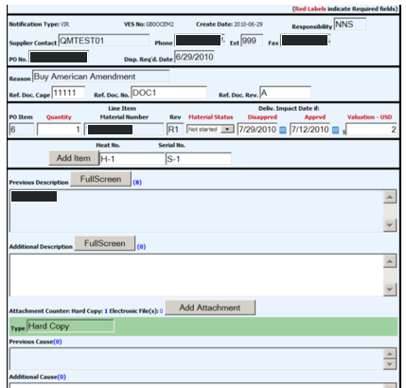
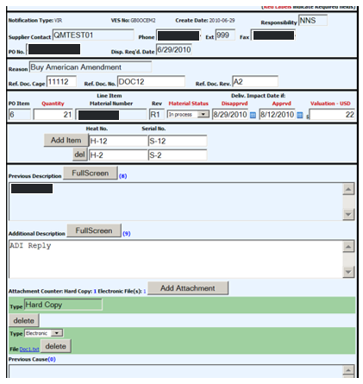
Additional Document Information (ADI), continued…
For VIRs, when placed in EDIT select fields will be available for edit; locked fields will appear shaded. New/additional attachments can be added and re-submitted.
Notes:
Only certain fields are reopened for correction or editing.
If further updates are required then a new replacement submittal will be required.

Slide 23
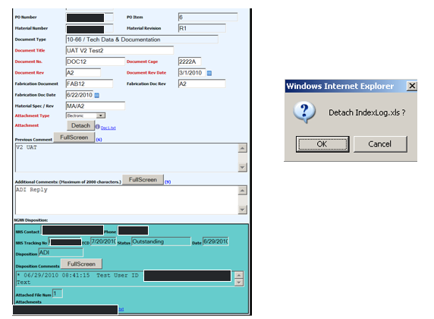
Additional Document Information (ADI), continued…
For other documents (including VPAR and VDER forms), when placed in EDIT status, select fields will be available for edit; locked fields will appear shaded. Attachments can be detached and replaced.
Notes:
Only certain fields are reopened for correction or editing.
If further updates are required then a new replacement submittal will be required.

Slide 24
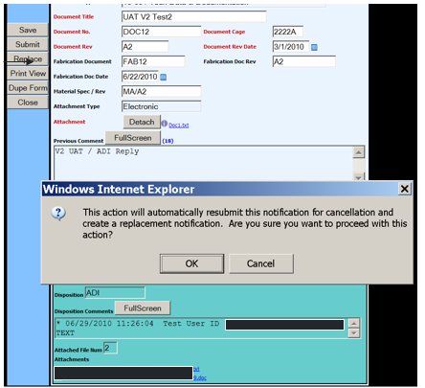
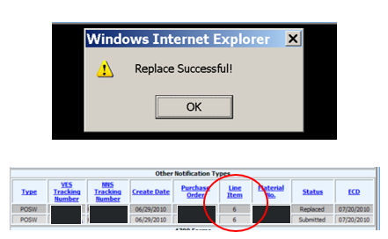
Additional Document Information (ADI), continued…
If it is found that the entire submittal needs to be replaced this can be done by clicking the Replace button; there will be a warning pop-up.
This action will submit the original submittal back to Newport News flagged for cancellation and copy a new submittal available for full edit. The replacement submittal will reference the original.
Notes:
If it is found that the entire submittal needs to be replaced this can be done by clicking the Replace button; there will be a warning pop-up.
This action will submit the original submittal back to Newport News flagged for cancellation and a copy of a new submittal will be available for full edit.
The replacement submittal will reference the original.

Slide 25
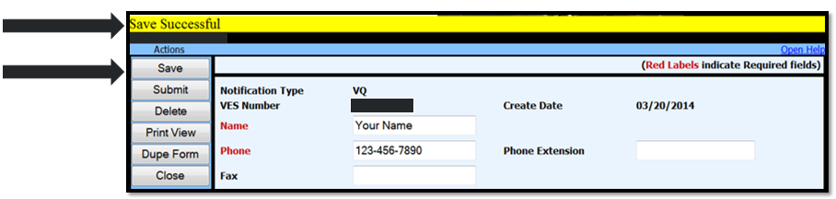
How to Save Submittals
At any given time, the user can save the submittal prior to submitting and sending to NNS.
After clicking the “Save” button, there will be confirmation of the save.
Note: Saving does not submit the submittal through SPARS to NNS.
Notes:
How to Save Submittals
At any given time, the user can save the submittal prior to sending.
After clicking the “Save” button, there will be confirmation of the save

Slide 26
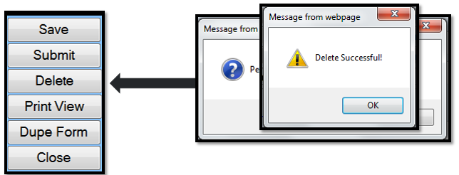
How to Delete Submittals
Prior to submitting a submittal, it can be deleted completely from SPARS.
Clicking the “Delete” button will bring a pop-up window to confirm the deletion.
After clicking OK there will be a confirmation that the action was successful.
Notes:
How to Delete Submittals
Prior to making a submittal, it can be deleted completely from SPARS.
Clicking the “Delete” button will bring a pop-up window to confirm the deletion.
After clicking OK there will be a confirmation that the action was successful.
NOTE: This action is not reversible.

Slide 27
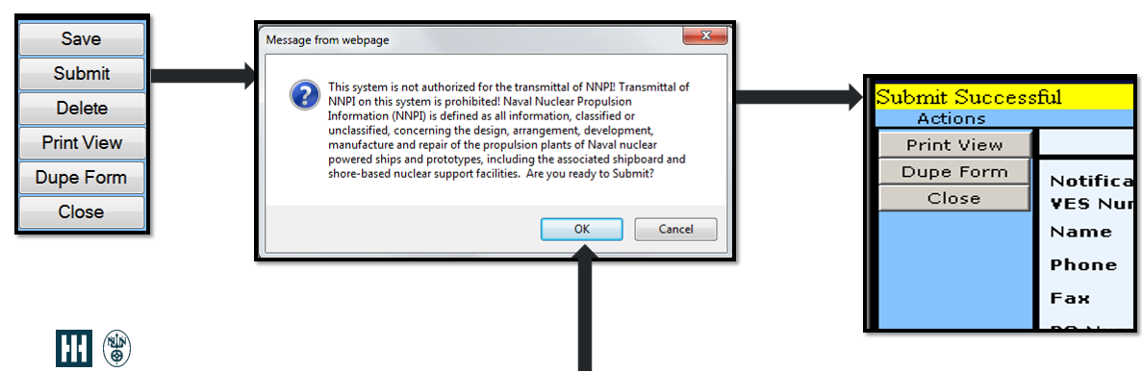
How to Submit Submittals
When ready, press the “Submit” button. There will be a reminder that this process should not be used for NNPI.
If there are no entry errors, a confirmation will be seen that the submittal was sent to NNS.
Notes:
How to Submit Submittals
When ready, press the “Submit” button.
There will be a reminder that this process should not be used for NNPI.
If there are no entry errors, a confirmation will be seen that the submittal was sent.
NOTE: the user should check back later to confirm that the submission was accepted.

Slide 28
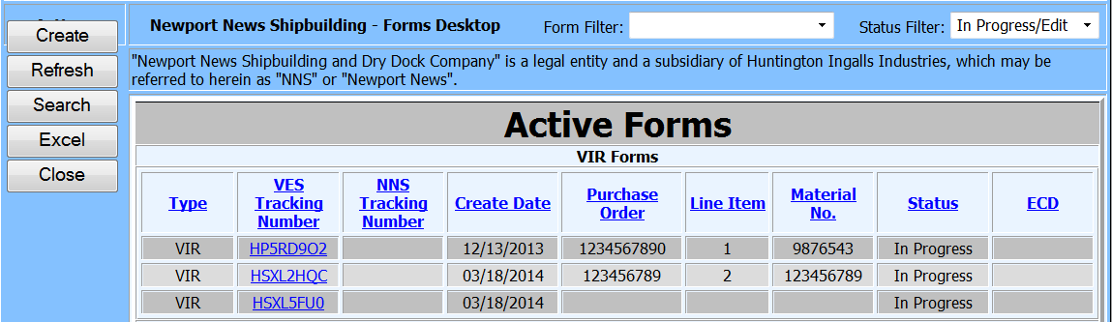
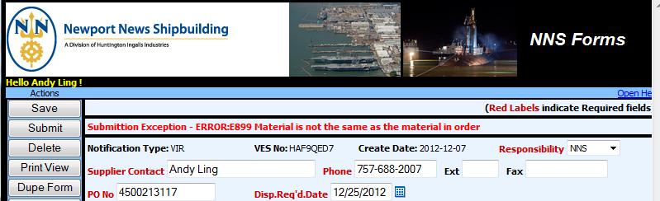
Failed Submittals
If and when submittals fail, open the intended document by clicking on the VES Tracking Number from the Active Forms list.
The reason for failure of the submittal process is displayed on the opened form.
NOTE: If the error message does not make sense, contact SPARS@hii-nns.com for help.
Notes:
Failed Submittals
If and when submittals fail, open the intended document by clicking on the VES tracking number from the Active Forms list.
The reason for failure of the submittal process is displayed on the opened form
This failure was caused because the system checked the listed PO and found that the material number (NNPN) listed is not the NNPN for the PO. Make certain that the purchase order number, purchase order line item number and corresponding material number all agree.
SPARS will send an email indicating the submittal failed.
If, after reviewing the error message, the user cannot determine the corrective action, contact NNS for help.

Slide 29
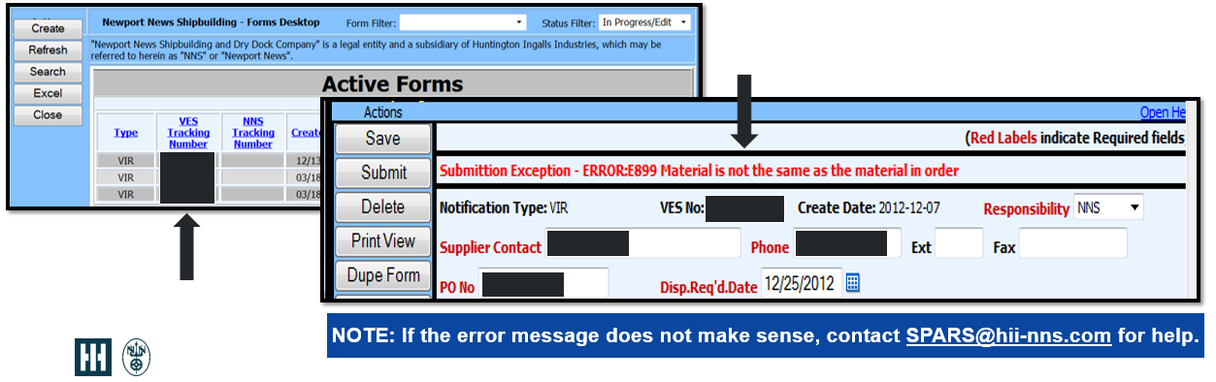
Status Before Submittal
While working on a submittal, the status will show “In Progress” until it is submitted.
When there is an error on a submittal the user will get an email notification and the status will show up as “In Progress” in RED. At this time, the submission can be edited/corrected.
Notes:
Status Before a Submittal
While working on a submittal, the status will show as “In Progress” until it is submitted
If the status font is red for a submittal, there was an error and a correction must be made. The user will be notified via email. At this time, the submission can be edited and corrected.

Slide 30
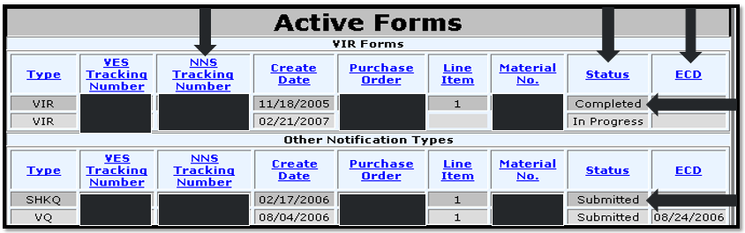
Status After Submittal
When a submission is successful, an e-mail will be sent to the user and the status in SPARS will change to “Submitted”.
The NNS Tracking Number and ECD fields will populated.
Once NNS has completed its review of the submittal, the user will receive another e-mail notification and the status will change to “Completed”.
Notes:
Status After Submittal
When a submission is successful, an e-mail will be sent to the user and the status in SPARS will change to “Submitted”.
The NNS Tracking Number and ECD fields will be populated.
If more than one regular business day goes by after a submittal without a NNS tracking number showing up, please contact the NNS buyer.
Once NNS has completed its review of the submittal, the user will receive another email notification and the status will change to “Completed”

Slide 31
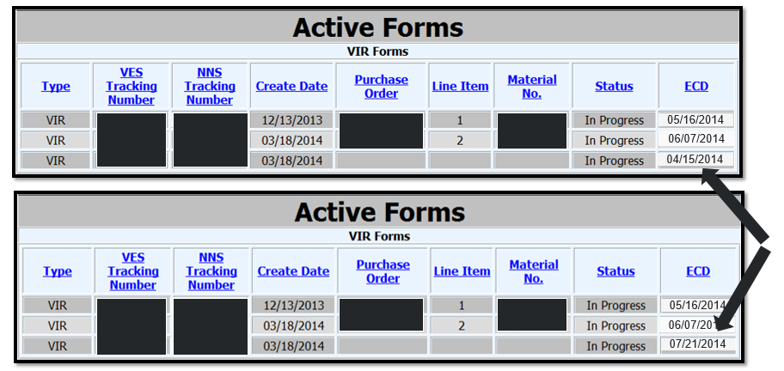
Estimated Completion Dates (ECD)
ECDs initially default to the date generated by the NNS internal system.
Later updates will reflect NNS review and other work to the submittal.
Notes:
Estimated Completion Dates (ECD)
After a submittal is made, an estimated completion date will be given automatically by the system.
Later updates will change this date, reflecting NNS review and other work to the submittal.

Slide 32
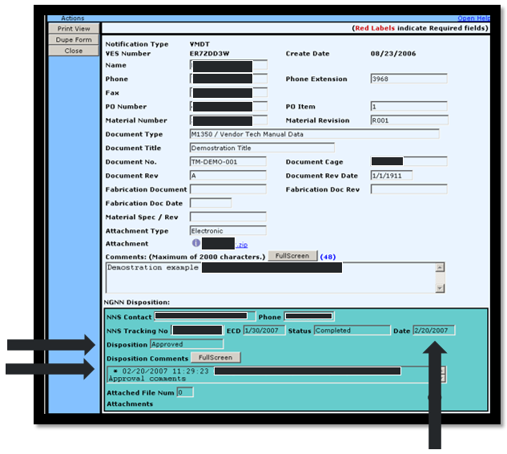
Completed Submittals
The completion date, submittal disposition and comments can be found on the detail screen.
Notes:
Completed Submittals
In opening up a submittal, a completion date, submittal disposition or any additional comments may show up in the detail screen.

Slide 33
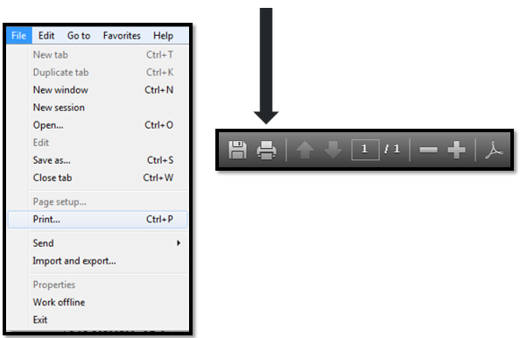
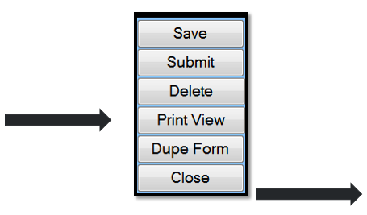
How to Print a Submittal
At any time, the user can print a record of the submittal being viewed by clicking on the “Print View” and then the “Print” icon.
Notes:
How to Print a Submittal
At any time, the user can print a record of the submittal by clicking on the “Print View” and then the “Print ” icon.

Slide 34
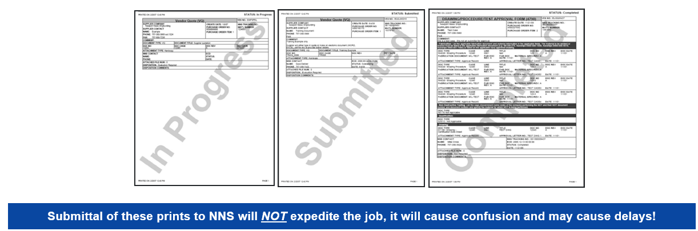
Printing Submittals
The status of each submittal will appear as a watermark over the print. The prints are for the originators' use.
Notes:
Example: Printing Submittals
The status of each submittal will appear as a watermark over the print.
The prints are for the originators' use.
NOTE: Submittal of these prints to the NNS buyer will NOT expedite the job, it will cause confusion! These are only for the user’s records

Slide 35
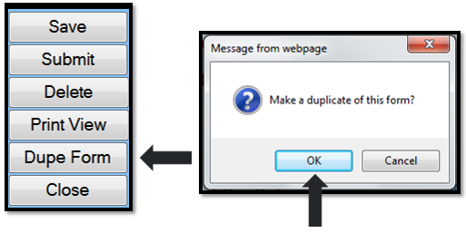
Duplicating a Submittal
If an existing submittal can be used as a template for another submittal, it can be copied and edited to meet the requirements of the new submittal, such as:
  Same PO but a different line item
  Same Part number from a different PO
  Similar qualification documents
This is accomplished by:
  Opening the form from the Active Forms screen.
  Click the “Dupe Form” button, then “OK” on the pop-up window.
Notes:
How to Duplicate a Submittal
If an existing submittal can be used as a template for another submittal, it can be copied and edited to meet the requirements of the new submittal, such as:
The Same PO but a different line item
The Same Part number from a different PO
Something with Similar qualification documents
This is accomplished by opening the form from the Active Forms screen
Click the “Dupe Form” button and then “OK” on the pop-up window.

Slide 36
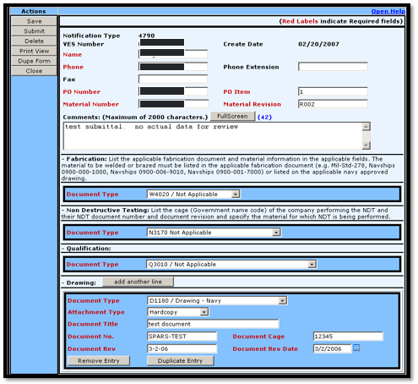
Duplicating a Submittal, continued…
The duplicated submittal will have all of the data that was on the original submittal.
Changes can then be made to any user input field including attachments, type, approval letter, etc.
  Press “Save” to save the form.
  Press “Submit” to submit.
Submittals may be copied or duplicated as many times as needed.
Notes:
How to Duplicate a Submittal (continued)
The duplicated submittals will have all of the data from the original form
Changes can be made to any user input field including attachments, type, approval letter, etc.
Press save to save the form
Press submit to submit the form
The “Dupe Form” function can be done an unlimited number of times, saving time and effort.

Slide 37
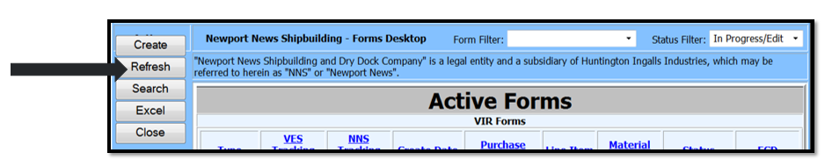
How to Refresh Active Forms
The Active Forms screen view can be updated by clicking the “Refresh” button.
This will update all fields with any new data since the last refresh or when the screen was opened.
Notes:
How to Refresh Active Forms
The Active Forms screen view can be updated by clicking the “Refresh” button.
This will update all fields with any new data since the last refresh or when the screen was opened.
If an update has been submitted while the user is actually in SPARS, the Refresh action will update immediately

Slide 38
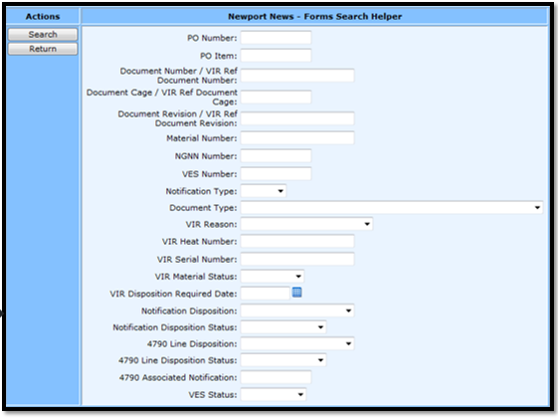
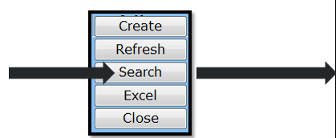
How to Search for Submittals
It is possible to search all submittals made on the supplier’s behalf, but only after they have been submitted.
The user can access this function by clicking the “Search” button on the Active Forms screen.
After selecting “Search”, this screen is displayed.
There are many ways to search for submittals.
The results will be shown on the “Active Forms” screen.
Notes:
How to Search for Submittals
It is possible to search for submittals made on the user’s behalf or
The user can search for their company’s submittals.
A company is recognized by a unique account number. Satellite locations which are part of a larger corporation are still treated as separate entities.
The user can access this function by clicking the “Search” button on the Active Forms screen
If the user wants to open a submittal by the Purchase Order number, type that number into the PO number field and then push the “search” button. The document will open. The results will be shown on the “active forms” screen.

Slide 39
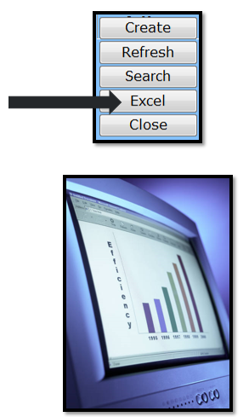
How to Export Submittals to Excel
It is possible to export the data on the Active Forms list to Excel.
The user can access this function by clicking the “Excel” button on the “Active Forms” screen.
The data that is present on the Active Forms list at that time will be exported to Excel.
Some additional data is also exported including Status date, Disposition and the name of the Buyer.
Normal Excel functions can be utilized at this time to manipulate the data for meeting user’s needs.
Notes:
How to Export Submittals to Excel
The user can export information on the Active Forms list to an excel spreadsheet.
The user can access this function by clicking the “Excel” button from the “active forms” screen.
Whatever data is displayed on the active forms list at that time will be exported into Excel.
Some additional data is also exported including status date, disposition, and the name of the Buyer
Normal Excel functions can then be utilized to manipulate the data for meeting the user’s needs.

Slide 40
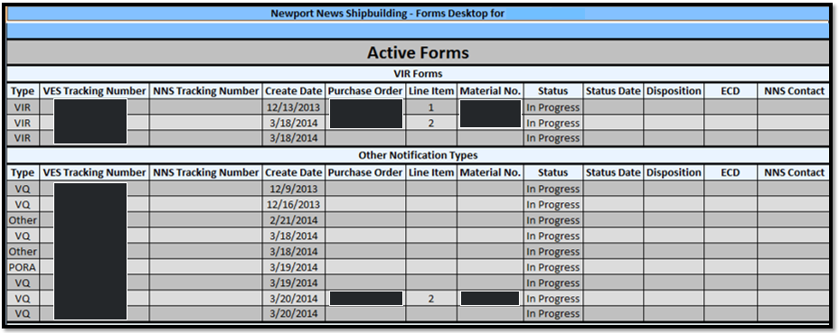
How to Export Submittals to Excel, continued…
Notes:
How to Export Submittals to Excel (continued)
Here is an example of an “export active forms” screen which is populated with a variety of information.
Remember only the data that was displayed on the active forms list at that time will be exported into Excel.

Slide 41
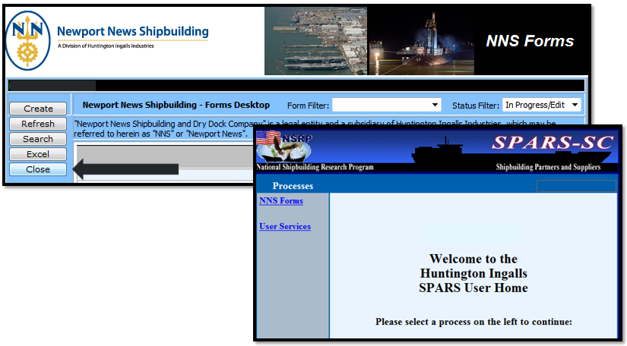
How to Close Active Forms
The Active Forms screen can be closed by clicking the “Close” button.
This will bring the user back to the SPARS landing/home page.
Notes:
How to Close Active Forms
The Active Forms screen can be closed by clicking on the “Close” button
This will bring the user back to the “Processes” screen.
Be sure to save all changes before leaving the site.

Slide 42
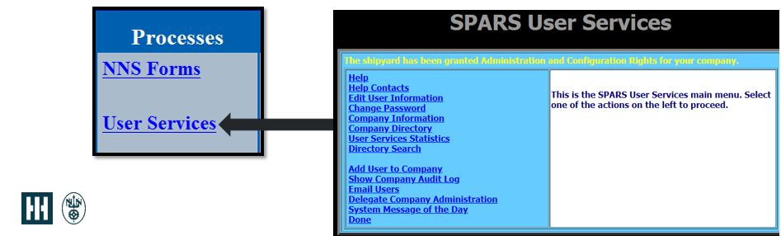
User Services
Selecting “User Services” will take the user to an utility menu to administer the account.
If you are a SPARS administrator for your Company, selecting “Add User to Company” will allow you to add and/or remove users from SPARS.
Clicking on “Help” will bring the user to a detailed document to assist with the different functions of this menu.
Notes:
User Services
Selecting “User Services” will take the user to the Utility Menu to administer the account
If you are a SPARS administrator for your Company, selecting “Add User to Company” will allow you to add and/or remove users from SPARS.
This section also contains a “Help” function that will bring the user to a detailed document to assist with the different functions of this menu

Slide 43
Important to Remember…
If the user’s software submittal contains NNPI then physical mail methods must be used. Contact your NNS Buyer to coordinate receipt and delivery of NNPI materials.
Service or non-material number submittals cannot go through SPARS.
All required RFQ / PO information must be correctly entered to ensure the submittal is processed.

Slide 44
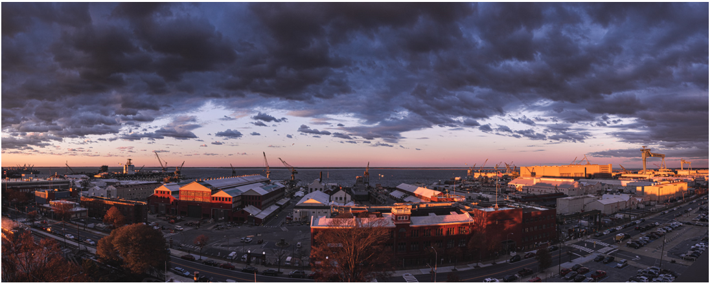
Thank you…
Any questions, contact your Newport News Shipbuilding (NNS) Buyer or your NNS SPARS Team at spars@hii-nns.com.

